Slide 1

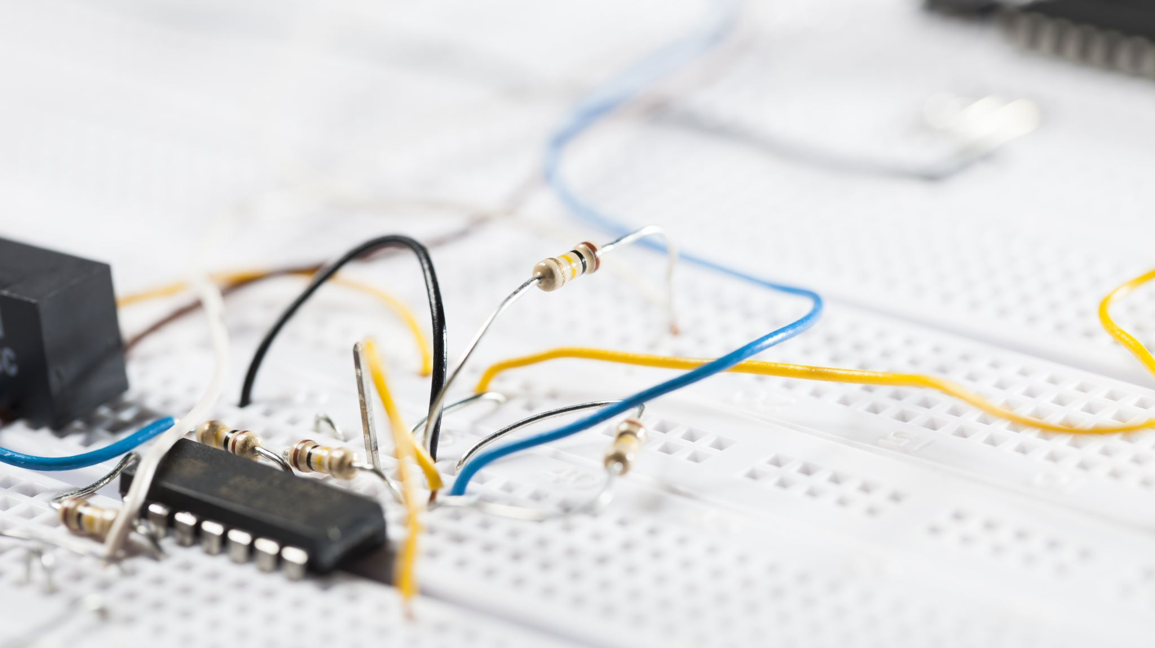
USAGE OF TRANSISTORS IN REAL LIFE
PRESENTED BY NAME: SHARANNAYA DEY SITHI ID: 19-40811-2

Slide 2

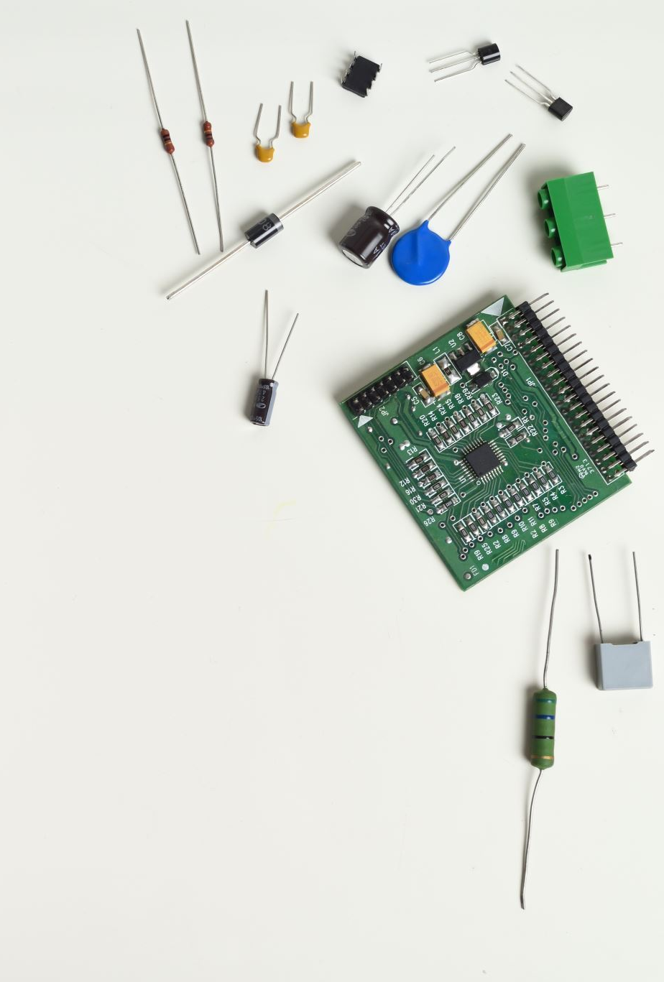
What is transistors?
A transistor is a semiconductor device used to amply or switch electrical signals and power.
A transistor is a combination of three electrical terminals
Emitter
Base
Collector

Slide 3
Types of TRANSISTORs
Transistors cam be broadly classified into three categories
Bipolar junction transistors (BJT)
Field-effect transistors (FET)
Insulated-gate bipolar junction transistors (IGBJT)

Slide 4
USAGE OF TRANSISTOR IN DAILY LIFE
1. AMPLIFIERS CIRCUITS
2. COMPUTER PROCESS
3. MICROPHONES
4. GRAPHICS PROCESSING UNITS
5. AIR CONDITIONERS

Slide 5
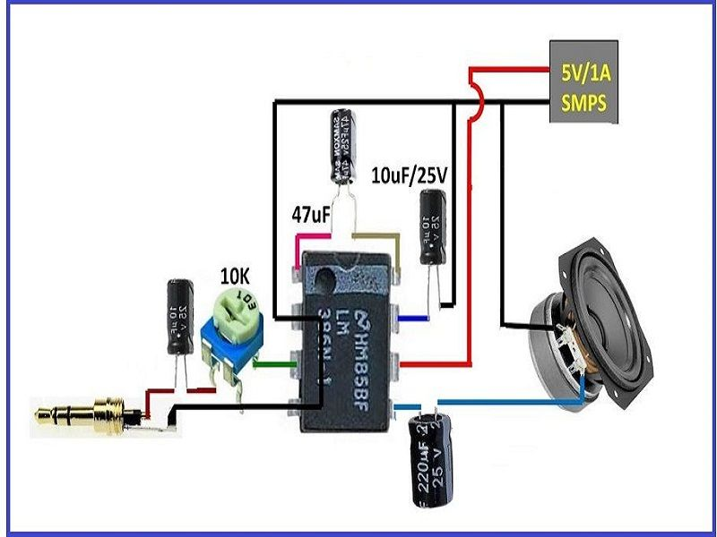
TRANSISTOR IN AMPLIFIER CIRCUIT
Amplification is the process by virtue of which the strength of a weak signal can be raised to a certain level.
2. Amplification is the process by virtue of which the strength of a weak signal can be raised to a certain level.
3. Amplification is the process by virtue of which the strength of a weak signal can be raised to a certain level.

Slide 6
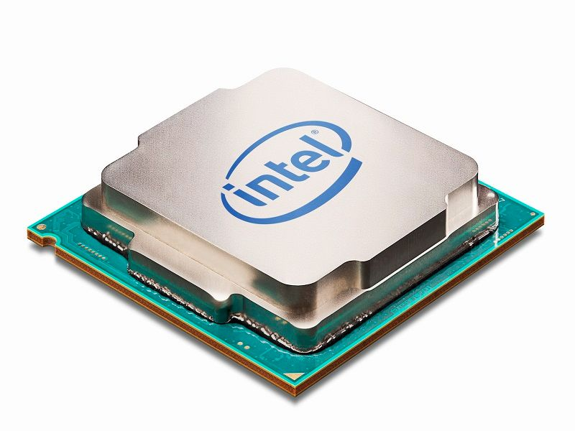
TRANSISTOR IN COMPUTER PROCESS
Transistors are known to be the basic building units of microprocessors and microcontrollers.
2. The processing units
used in computers are basically an assembly of multiple transistors interconnected to each other in cascaded or parallel form. The switching and other related operations of transistors help a person operate the computer

Slide 7
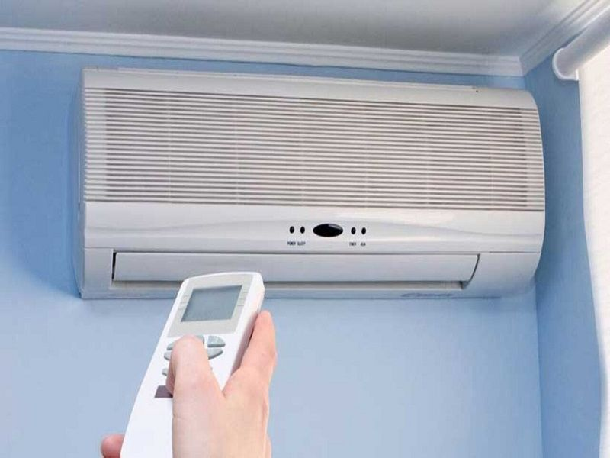
TRANSISTOR IN AIR CONDITIONER
Air conditioners tend to form yet another example of the daily use gadgets that makes use of transistors. The sensors used by the air conditioners to compare the room temperature with the desired temperature consists of an assembly of transistors that act as comparators.
the task of sending and receiving signals back and forth between the device’s internal circuitry and the external environment is controlled and manipulated by transistors.
the task of sending and receiving signals back and forth between the device’s internal circuitry and the external environment is controlled and manipulated by transistors.

Slide 8
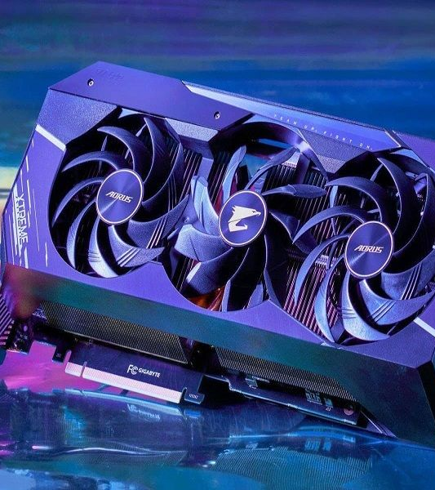
TRANSISTRANSISTOR IN GRAPHICS PROCESSING UNITS
GPU or graphic processing unit is an integral part of the devices where graphics rendering is primarily desired.
GPU or graphic processing unit is an integral part of the devices where graphics rendering is primarily desired.

